Slide 1
Introducing a Reference Input
Designing M and N
  Design so that estimator performance is independent of reference input
  General design of choosing overall system zeros
Output error command structure
  Difference between transfer function and state-space compensator design approaches

Slide 2

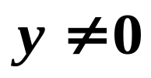

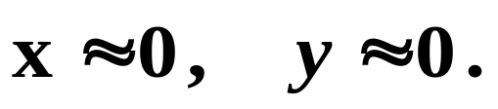

Introducing a Reference Input
Thus far, we have assumed that the reference input is zero. That is, we want y = 0, thus in steady state, x = 0 and u = 0. If there are disturbances that cause
and , then we have to reject the disturbances to bring
Now suppose we want
What is the best way to introduce r into the system?

Slide 3
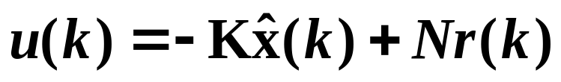
Controller Equations
Since r is an external signal, M and N do not affect the closed-loop characteristic equation. That is, the poles of the system are fixed, hence M and N do not affect stability.
M and N affect the locations of zeros, which affect the
transient response of the system.
M and N also affect steady-state error.

Slide 4

Designing M and N
The most common way is to select M and N such that
The idea here is that if the estimator is good, it should be good independent of any external excitation.
This is not the most general way of designing M and N though. The most general way is to design n zeros, then solve for M and N to yield those zeros.

Slide 5

Estimator Error Dynamics Equation
If r does not affect estimator performance, then
M = Γ N

Slide 6


Controller Equations
Originally:
Now:

Slide 7
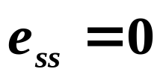
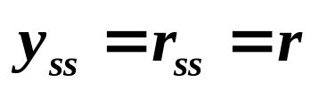



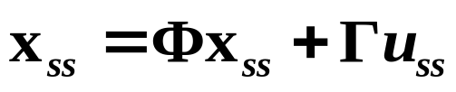
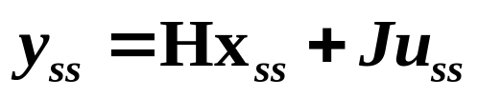
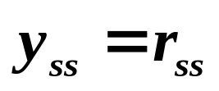



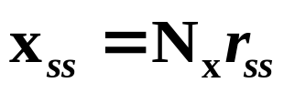
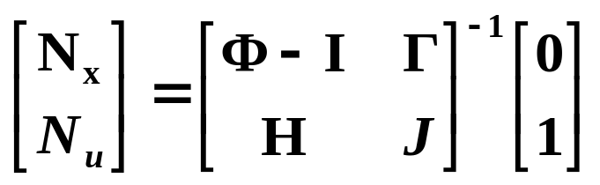
Designing N
For a constant r , we want so that .
Plant:
In steady-state:
We want , then:
is some constant scalar:
is some constant vector:

Slide 8
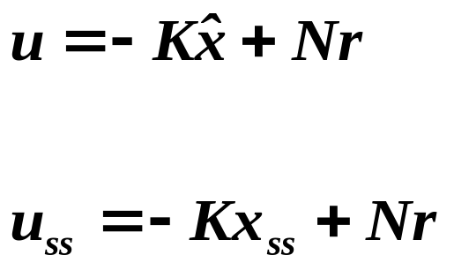
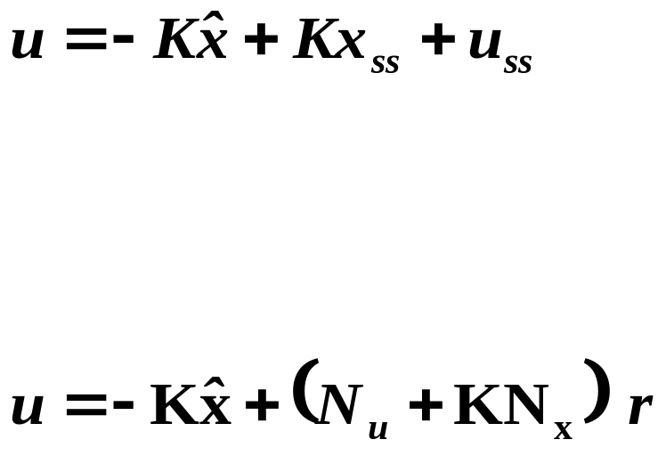
Now, we can write
In steady-state,
Thus,

Slide 9




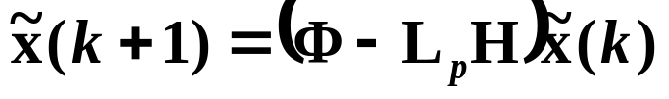
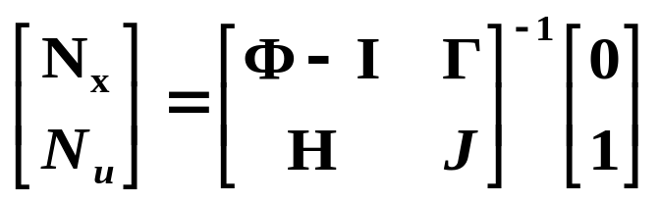
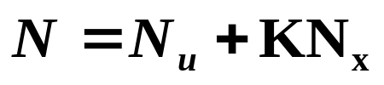

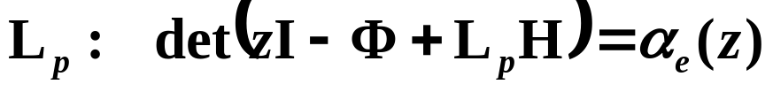
Overall System State Equations
with Non-Zero Reference Input
Plant G(z):
Compensator D(z):

Slide 10
















State-Command Structure
Drives the plant model in the estimator with the same inputs that are applied to the actual plant.
Σ
Plant, G(z)
Σ
Σ

Slide 11



General Case Where Zeros Are Designed
1. Consider the case of only state feedback with no
estimator, but with a non-zero reference input:

Slide 12
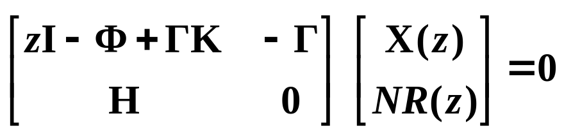
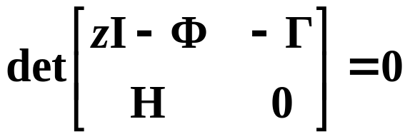
What are the zeros?

Slide 13
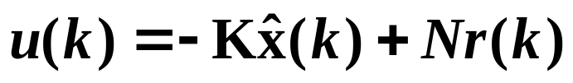
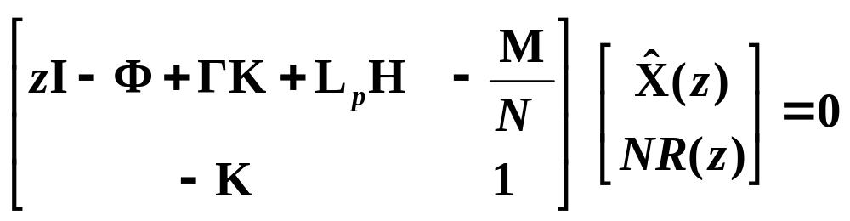
2. Consider the case of the combined controller and estimator with non-zero reference input:
What are the zeros from r(k) to u(k)?
Without loss of generality, assume y(k) = 0.

Slide 14
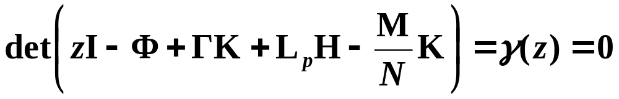
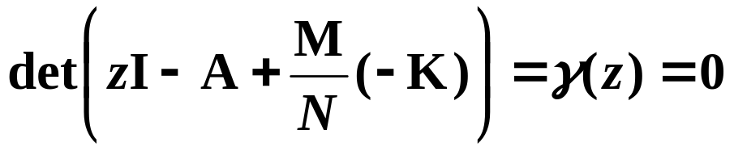

Compare with estimator problem:

Slide 15
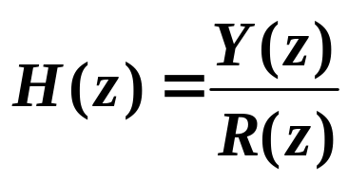



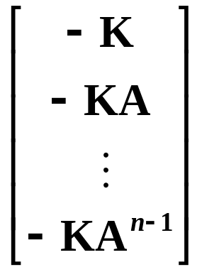
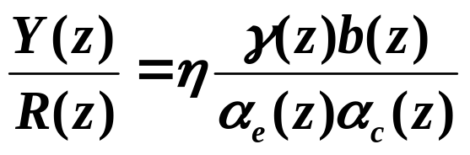
We can choose zeros of compensator D(z) , and hence
If is observable, then can choose desired zeros, then form and solve for

Slide 16


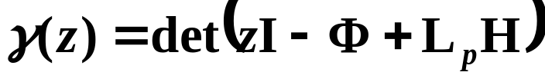
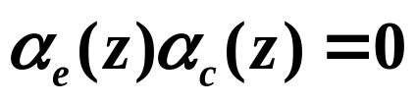
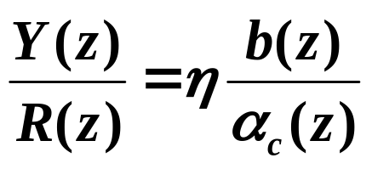
Special case:
What are the zeros from r(k) to u(k) ?
Overall poles of the system are:

Slide 17








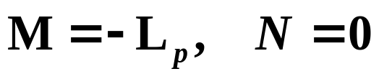

Output Error Command Structure
Σ
The compensator equations:
Since we need all r and y terms only in terms of (r - y), we must have and the compensator equations become:

Slide 18
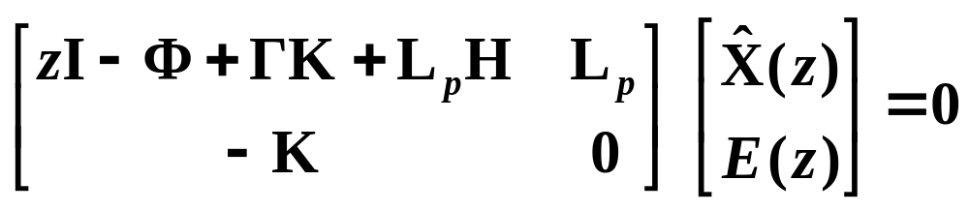
What are the zeros of D(z) ?

Slide 19
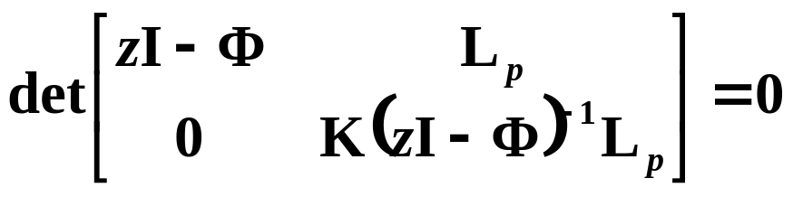




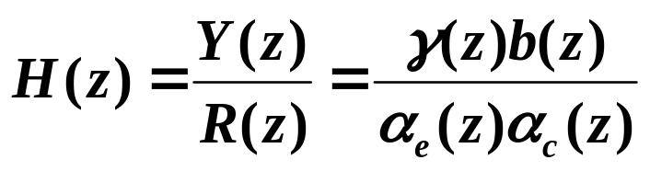
Σ
These are zeros of the compensator, and they will be the zeros of the overall system unless they are cancelled by plant poles.

Slide 20
Difference Between Transfer Function and
State-Space Compensator Design Approaches
Drawback of transfer function approach:
Zeros of the compensator D(z) become zeros of the overall system H(z).
Advantage of state-space compensator with M = ΓN :
Overall transfer function of the system only has plant zeros. The compensator does not add any additional zeros. This makes it often easier to predict the response.

